Slide 1

AeroGotchi
An OoeyGUI Presentation

Slide 2

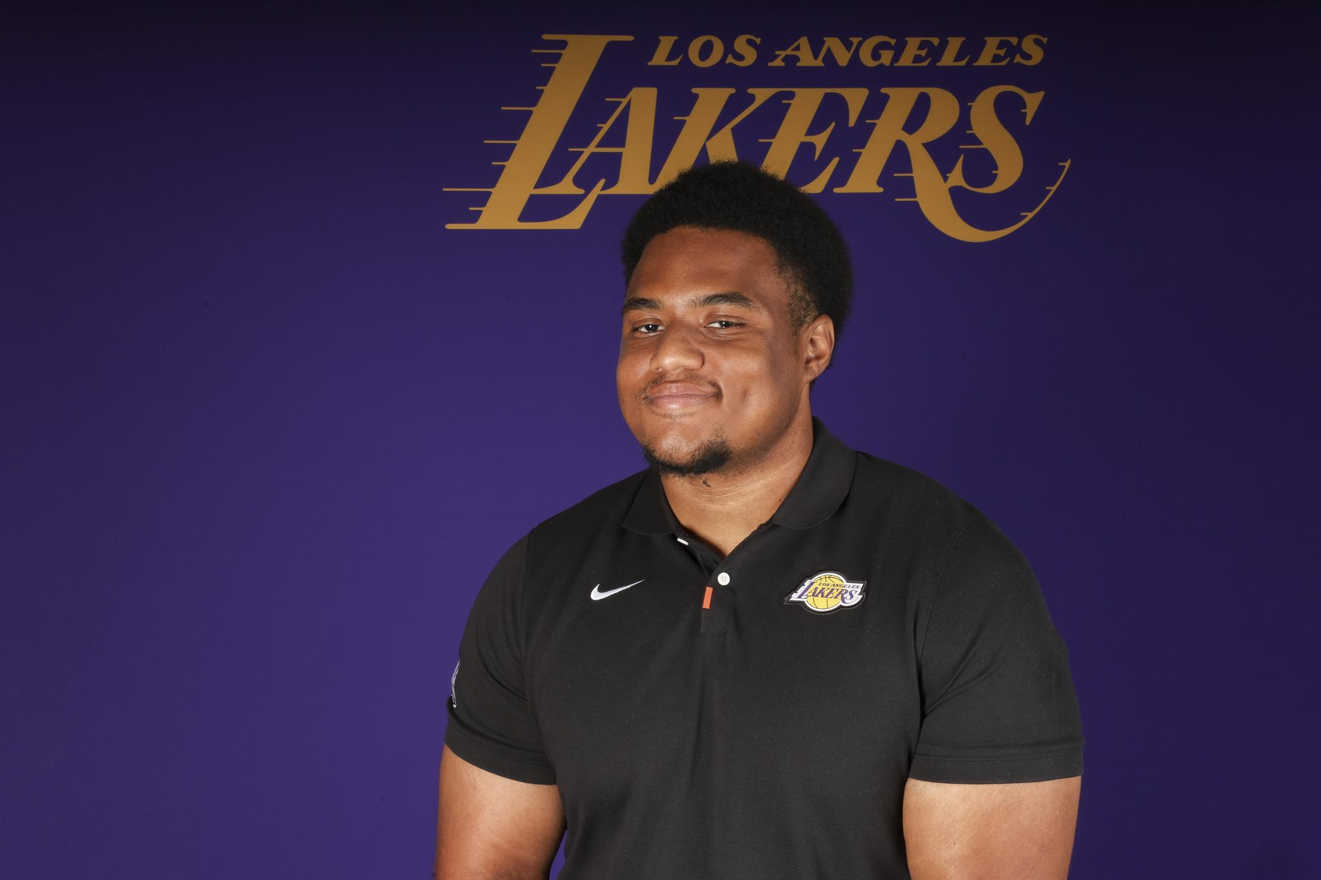


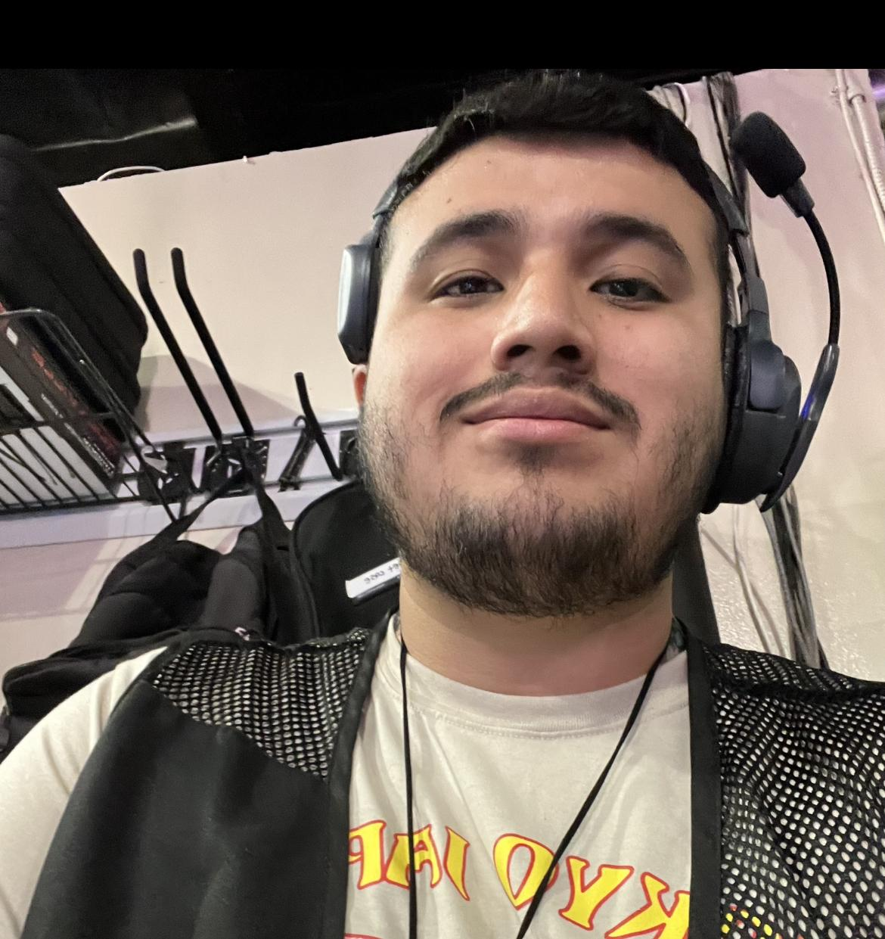
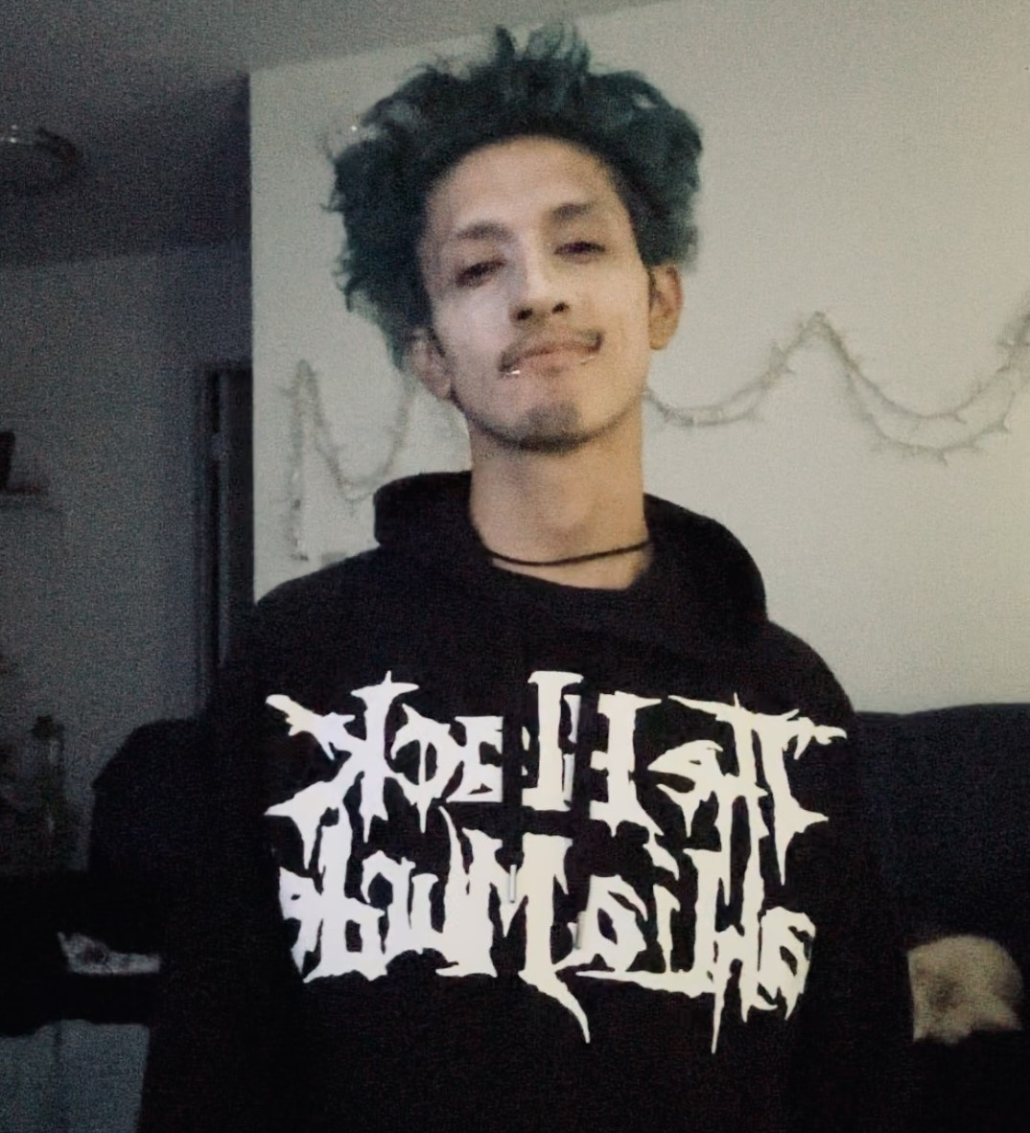
Team members
<Inderjit Singh>
Elijah Lockett
Jarrett McIntire
Keith Chua
Peter Hernandez
Zamir Barbosa

Slide 3
Agenda
Project Overview
Project Overview
Problem Definition
Problem Definition
Application Screenshots
Application Screenshots
Software Overview
Software Overview
Sample Code Representation
Sample Code Representation
Progress and Future Work
Progress and Future Work
Questions
Questions

Slide 4
Project Overview
Aerogotchi is a mobile application that merges the charm of digital pets, exemplified by games like Tamagotchi, while incorporating essential drone technology.
Aerogotchi is a mobile application that merges the charm of digital pets, exemplified by games like Tamagotchi, while incorporating essential drone technology.
The project’s core focus is the development of a mobile application that not only facilitates drone controls but also introduces captivating gaming elements.
The project’s core focus is the development of a mobile application that not only facilitates drone controls but also introduces captivating gaming elements.
This aims to provide users with a unique experience where users have the joy of nurturing a virtual pet by user interaction with the excitement of interacting with the drone.
This aims to provide users with a unique experience where users have the joy of nurturing a virtual pet by user interaction with the excitement of interacting with the drone.

Slide 5
Problem Definition
The AeroGotchi project involves creating an autonomous pet drone system using Python and Flutter. The challenge is to design a modular program structure, balancing user interaction and drone technology exploration.
The AeroGotchi project involves creating an autonomous pet drone system using Python and Flutter. The challenge is to design a modular program structure, balancing user interaction and drone technology exploration.
The goal is to offer a Tamagotchi-style game experience, providing a virtual companion without real pet responsibilities. Ensuring a user-friendly interface in Flutter and seamless communication between the mobile app and drone through a controller are key aspects.
The goal is to offer a Tamagotchi-style game experience, providing a virtual companion without real pet responsibilities. Ensuring a user-friendly interface in Flutter and seamless communication between the mobile app and drone through a controller are key aspects.
The architectural design must outline subsystem roles and connections, emphasizing a high-level understanding of their collaboration for effective functionality.
The architectural design must outline subsystem roles and connections, emphasizing a high-level understanding of their collaboration for effective functionality.

Slide 6
Application Screenshots

Slide 7
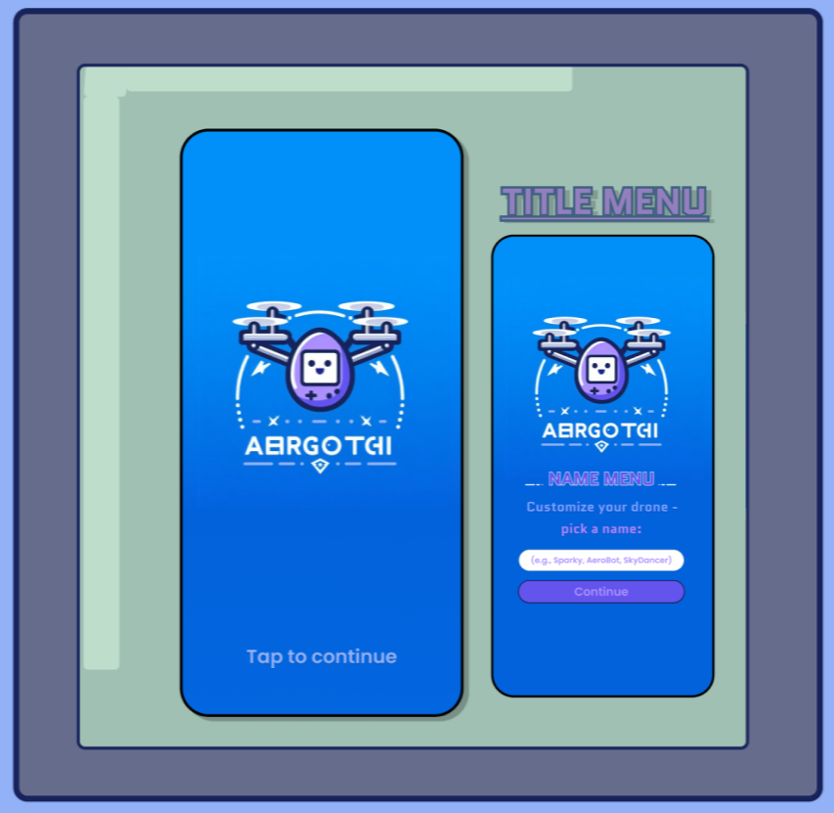
Notes:
Here is a mockup of our Title Menu which is the first thing that the user will be greeted with when they first open our mobile application. You’ll notice of logo courtesy of BingChat and DALLE 3. Once you tap to continue, you’ll be able to name your virtual pet drone.

Slide 8
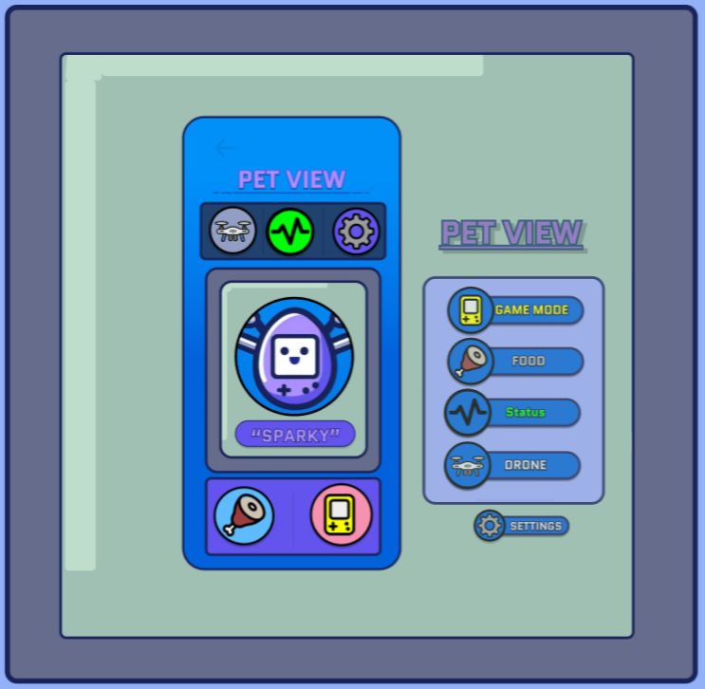
Notes:
Here is our Pet View, which is also our home menu. In the middle you’ll find an animated version of your pet along with its name, surrounded by a series of icons that will take you to the other interactions that you can have with your virtual pet drone.

Slide 9
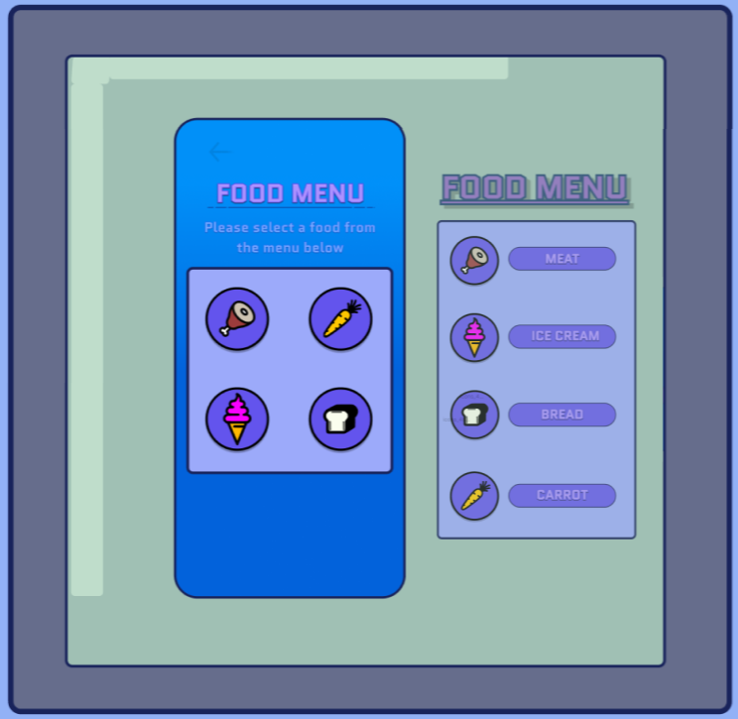
Notes:
Clicking on the food menu icon will take you to the food menu when you can select from a variety of different foods to feed your virtual pet drone when its food bar is low. Once you pick one of the food menu icons, you will return to the pet view menu and your both the animated virtual pet drone in the app and real life drone will do a happy food dance and some of its food bar will be restored.

Slide 10
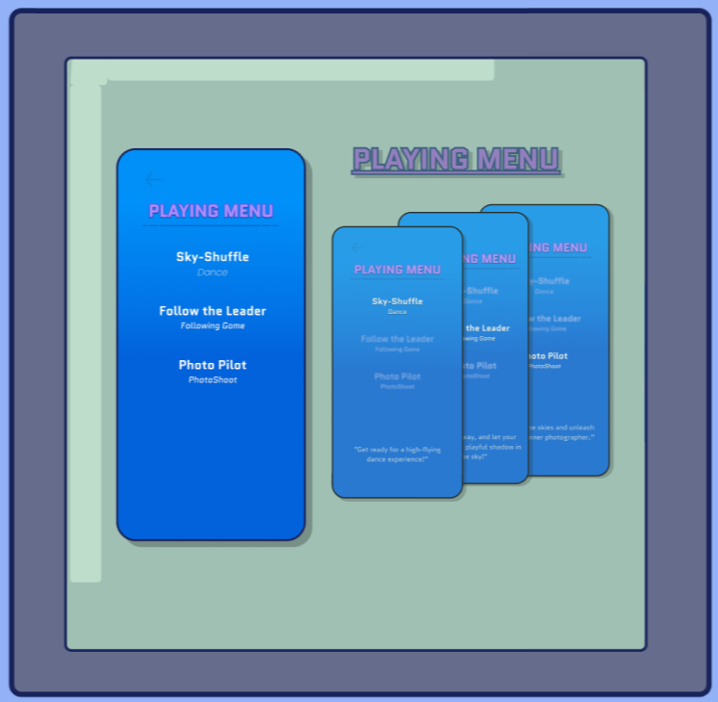
Notes:
So, this is The Playing Menu and its like the center for the interactive drone games.
-You can select from three games currently.
-One of them being “Sky shuffle” a type of Dancing game,
-the other is a type of following game called “Follow The Leader “ its similar to a simon says.
-And our last game is photopilot which is fun photo shoot game.

Slide 11
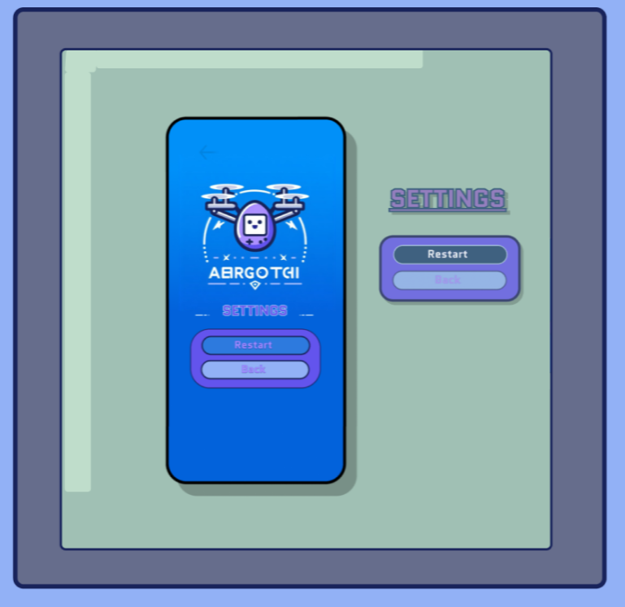
Notes:
The Settings Menu is where you can initiate a game reset.
- It provides us with the ability to do a HARD reset of the game.
- Doing this will allow us to do things like pet renaming.

Slide 12
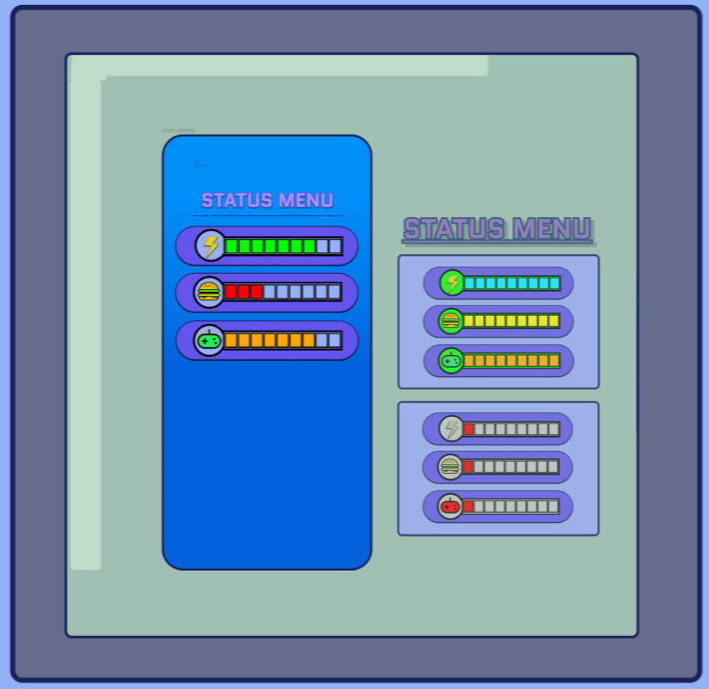
Notes:
The Status Menu gives us the ability to view at-a-glance the pets metrics
- it gives us real-time information on stuff like energy, hunger, and excitement - There is a view of the status bars when they full and empty.

Slide 13
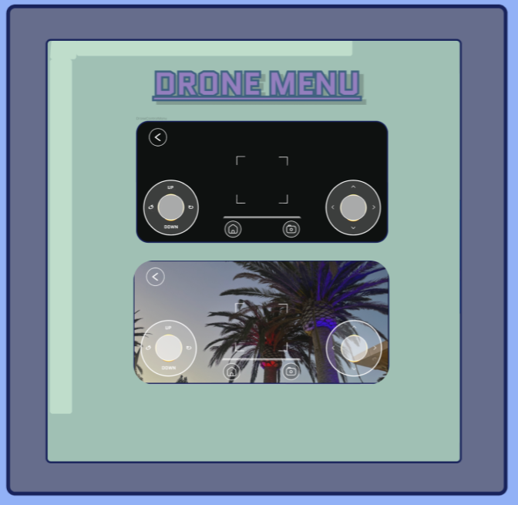
Notes:
The Drone Control menu gives us control over the drone's movements from our mobile device.
-It includes what's needed for essential functionalities.for example It includes Left and right joysticks.
-The left is to manage altitude and rotation, and the right joystick handles forward, backward, left, and right movements.
-There is also a camera button to capture a picture from the drone point of view. and home/back button to return to the petview menu and

Slide 14
Software Overview

Slide 15
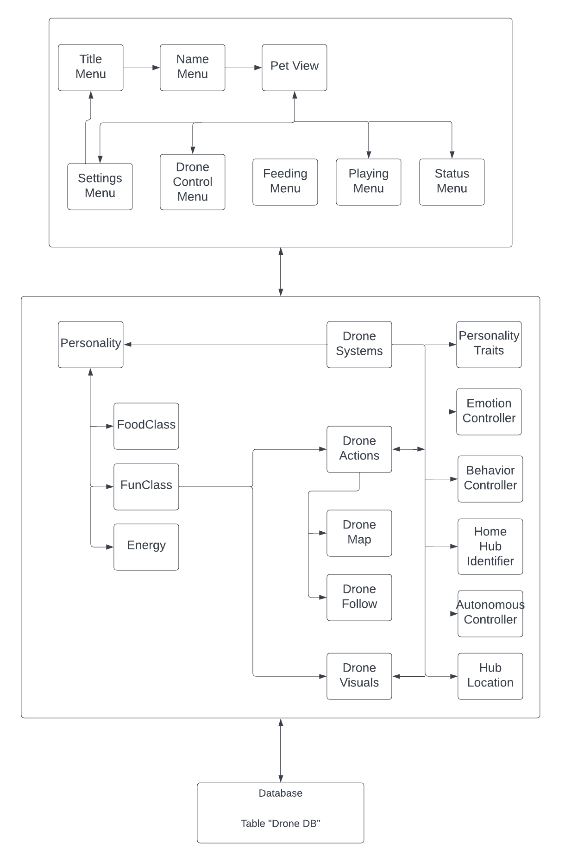
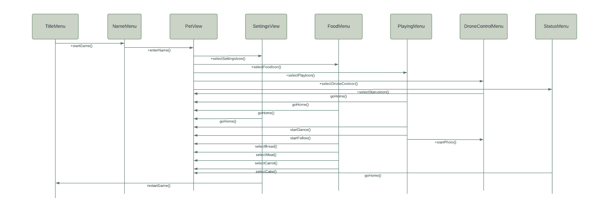
System Architecture
Front End SD
Notes:
System Architecture:
Three Tier Styles Architecture
Front End, Client Side, will be written using Flutter
Back End written in Python is our Business Logic
Small Database Design holding carryover data, like statuses, pet name and other data needed for the user to re-login
Front End SD:
Starts with Title Menu which connects to a Name Menu, which will only appear the first time the user connects the drone
Then we get to Pet View, which is the main part of the app, that connects to and from the all the other sub-menus

Slide 16
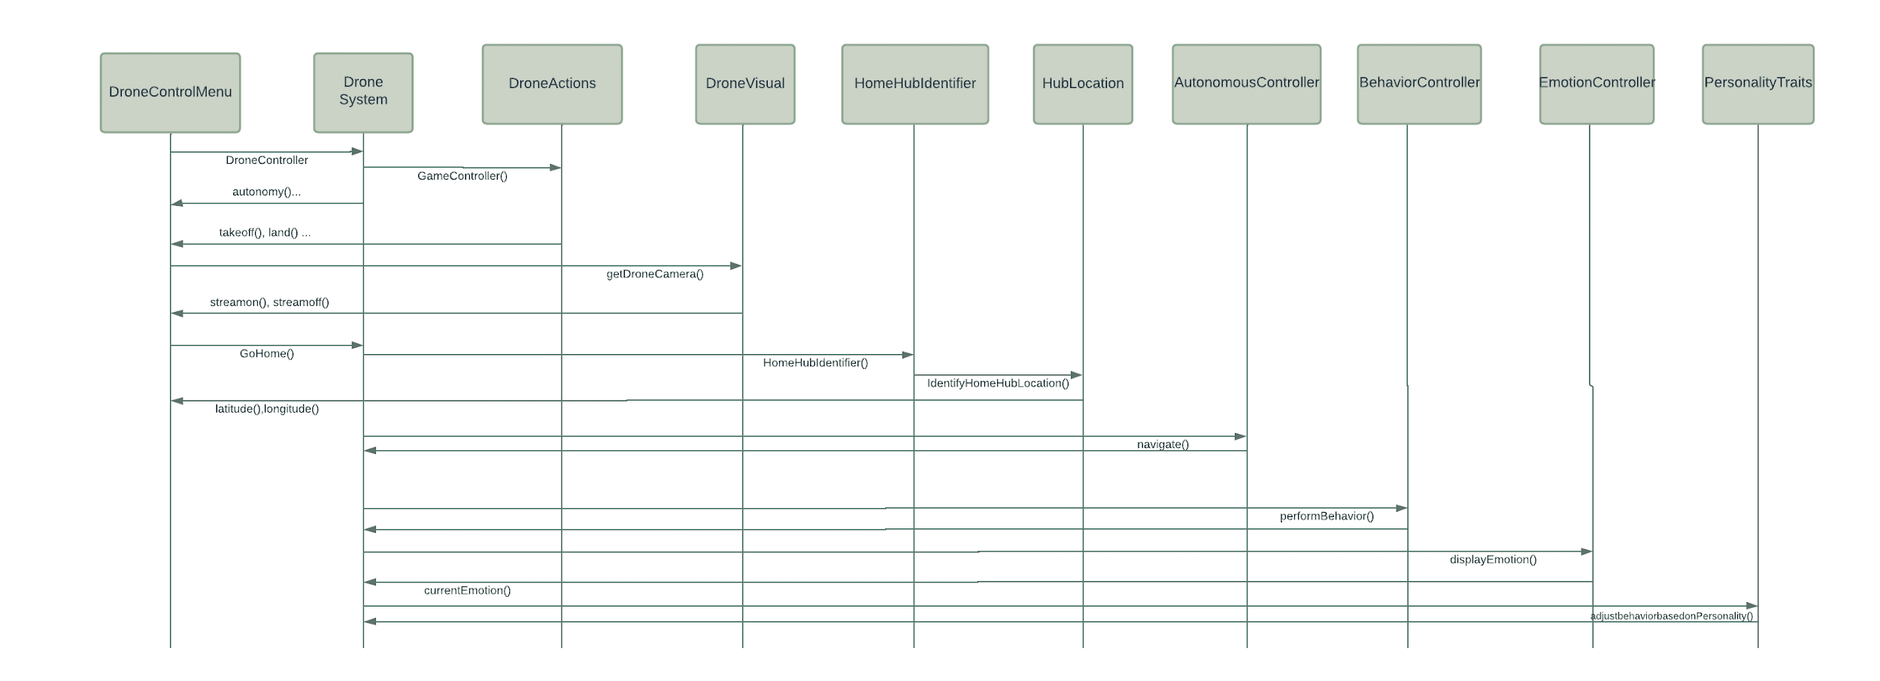
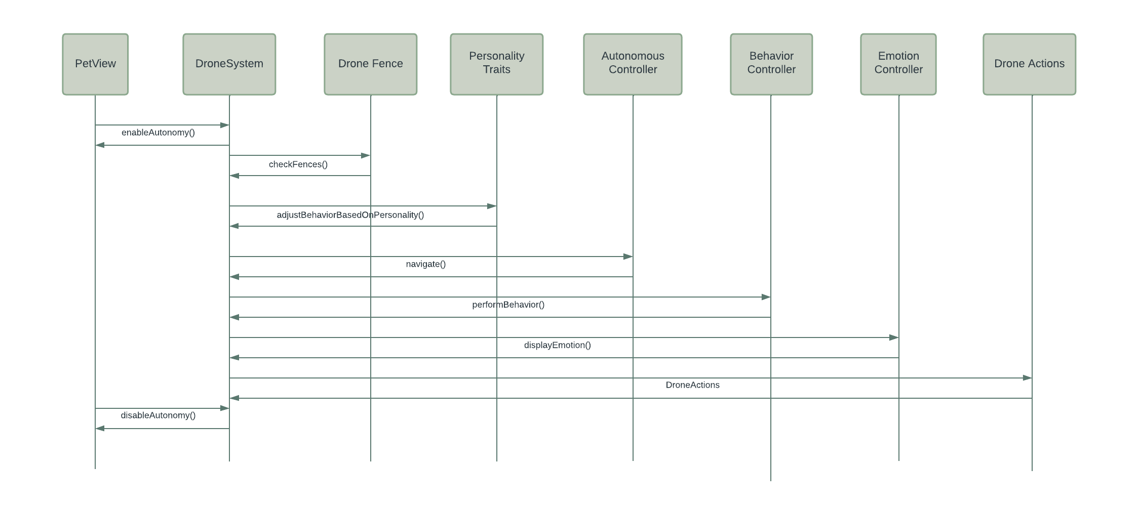
Drone Control Menu SD
Pet View SD
Notes:
Drone Control Menu SD:
As seen in the application screenshots, the Drone Control Menu has digital joysticks that allow the user move the drone in every direction with a camera view that is received from Drone Visuals in the middle of the SD
Features such as the camera button, that allows the user to take a photo from the drone perspective, the back button, that allows the user to go back to the Pet View
The Home button that was seen in the Control Menu is an autonomous feature that allows the drone to hover over then land on its Home Hub, which is essentially the initial point of the drone’s takeoff
Pet View SD:
Has a connection with Drone System to allow the AeroGotchi to have autonomous control outside of game mechanics
Application Screenshots later can show off this User Flow more easily.

Slide 17
Sample Code Representations
Instead of presenting actual code snippets in this class at the moment, we prefer to offer a visual representation through class diagrams, providing a conceptual overview of how the classes will be structured.

Slide 18
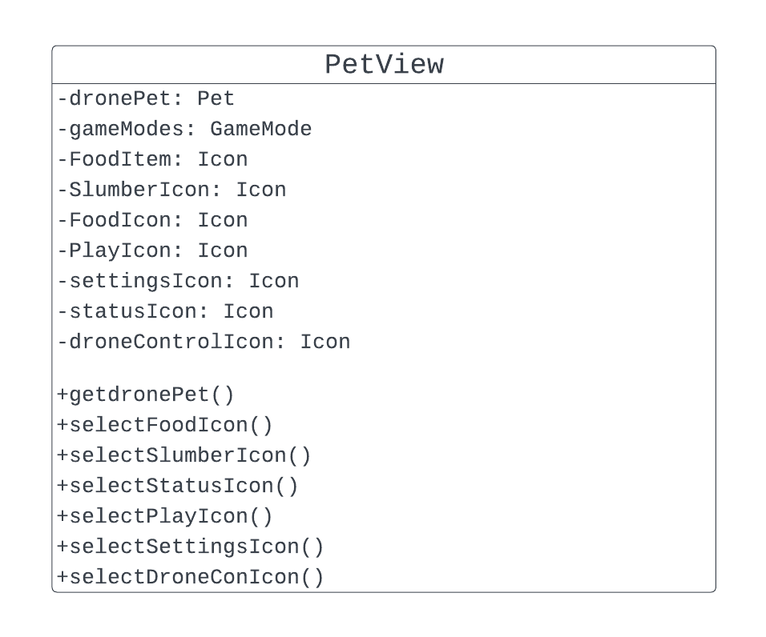
Class Diagram Frontend
All the menus will be selectable from the PetView. This includes Food Menu, Status Menu, Playing Menu, Settings Menu, and Drone Controller Menu.

Slide 19
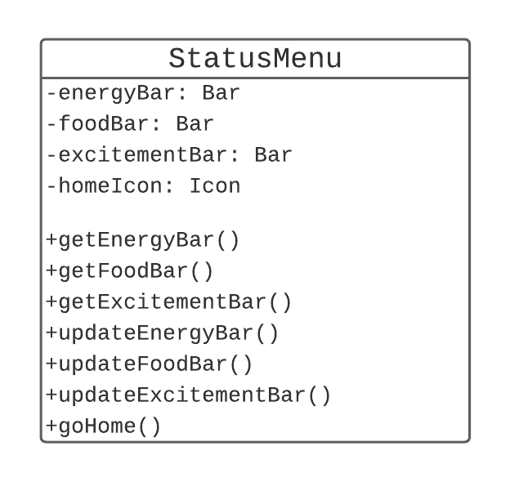
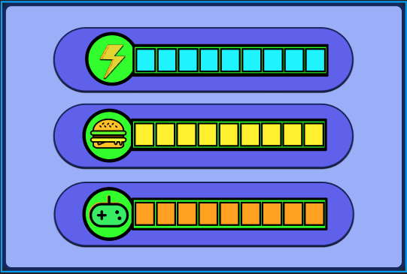
Class Diagram Frontend
The StatusMenu displays the food, excitement, and energy bar.

Slide 20
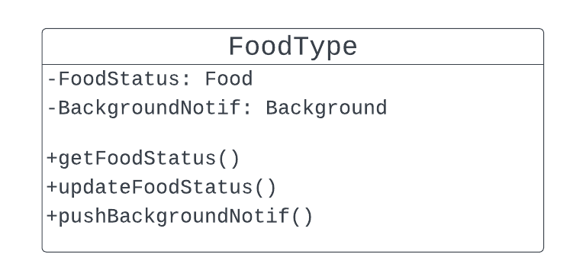
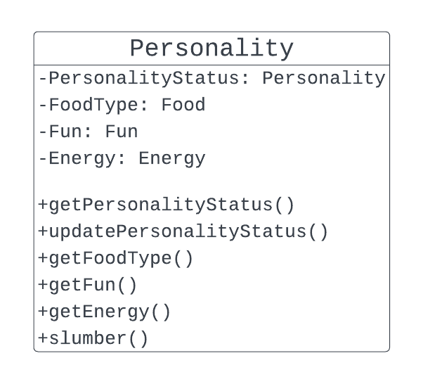
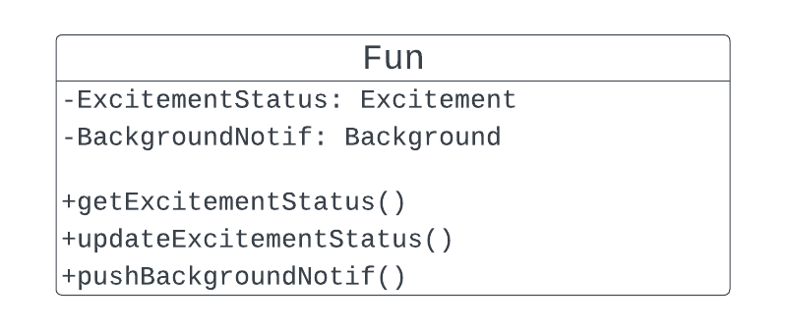
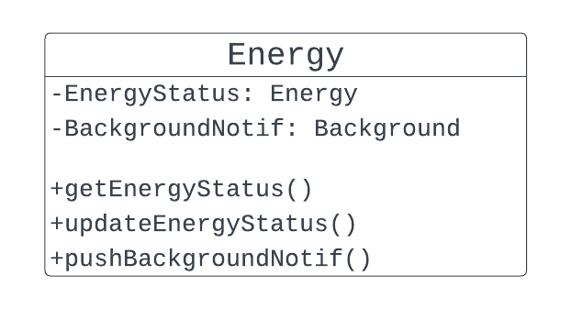
Class Diagram Backend
Notes:
Personality is a mechanic in the game that is linked to food, fun, and energy. For example, depending on your drone pets personality, it may gain more excitement playing dancing, rather than taking photos.

Slide 21
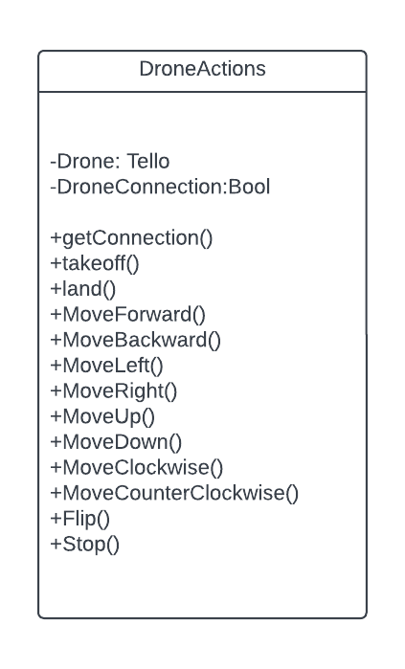
Class Diagram Drone
The DroneActions class will be responsible for the physical movements of the drone.

Slide 22
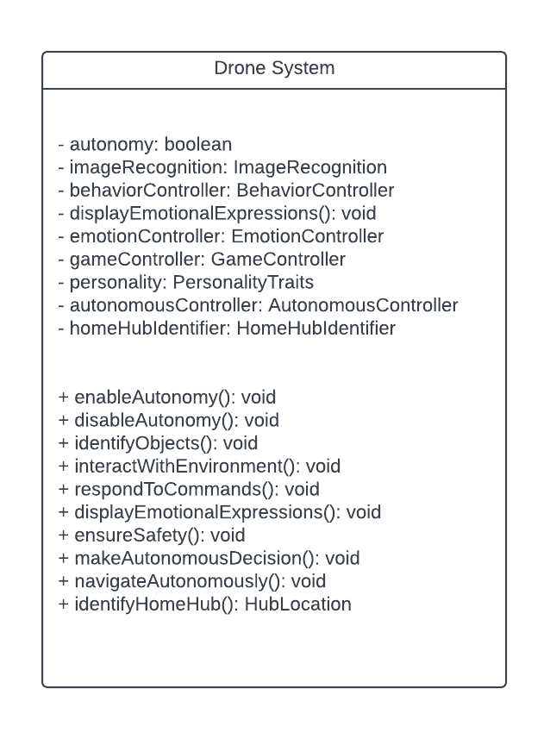
Class Diagram Drone ( cont. )
The DroneSystem class diagram is the beginning stages for the computer vision aspect of the drone.

Slide 23
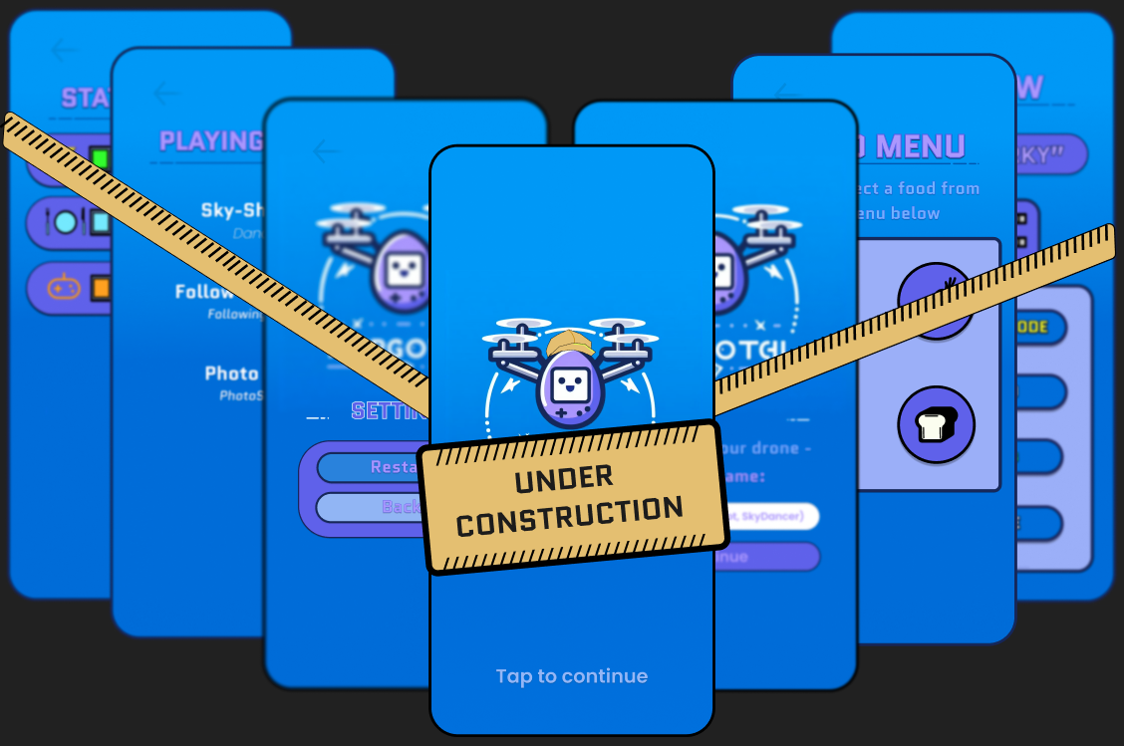
App Demo
In addition to the showcased screenshots within the application, the app demo will be shown in COMP 491.

Slide 24
Progress and Future Work
Progress
Progress
Build application.
Build application
Connect frontend and backend and also link the drone to the mobile application.
Connect frontend and backend and also link the drone to the mobile application
UI/UX
UI/UX
Finalize design language and unify themes.
Finalize design language and unify themes.
Future Work
Future Work
Upgrade drone hardware
Upgrade drone hardware.
Add more games, increase interactivity between human and drone
Add more games, increase interactivity between human and drone.

Slide 25
Questions?

